Slide 1
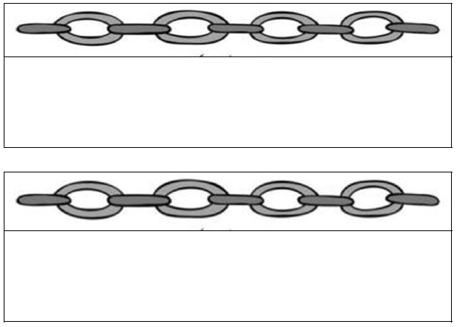
Making a Chain:
Try and link together 3 or 4 of the concepts in the table and explain how they link.
 | 1 | 2 | 3 | 4 | 5 | 6
A
B
C
D
E

Slide 2
