Slide 1
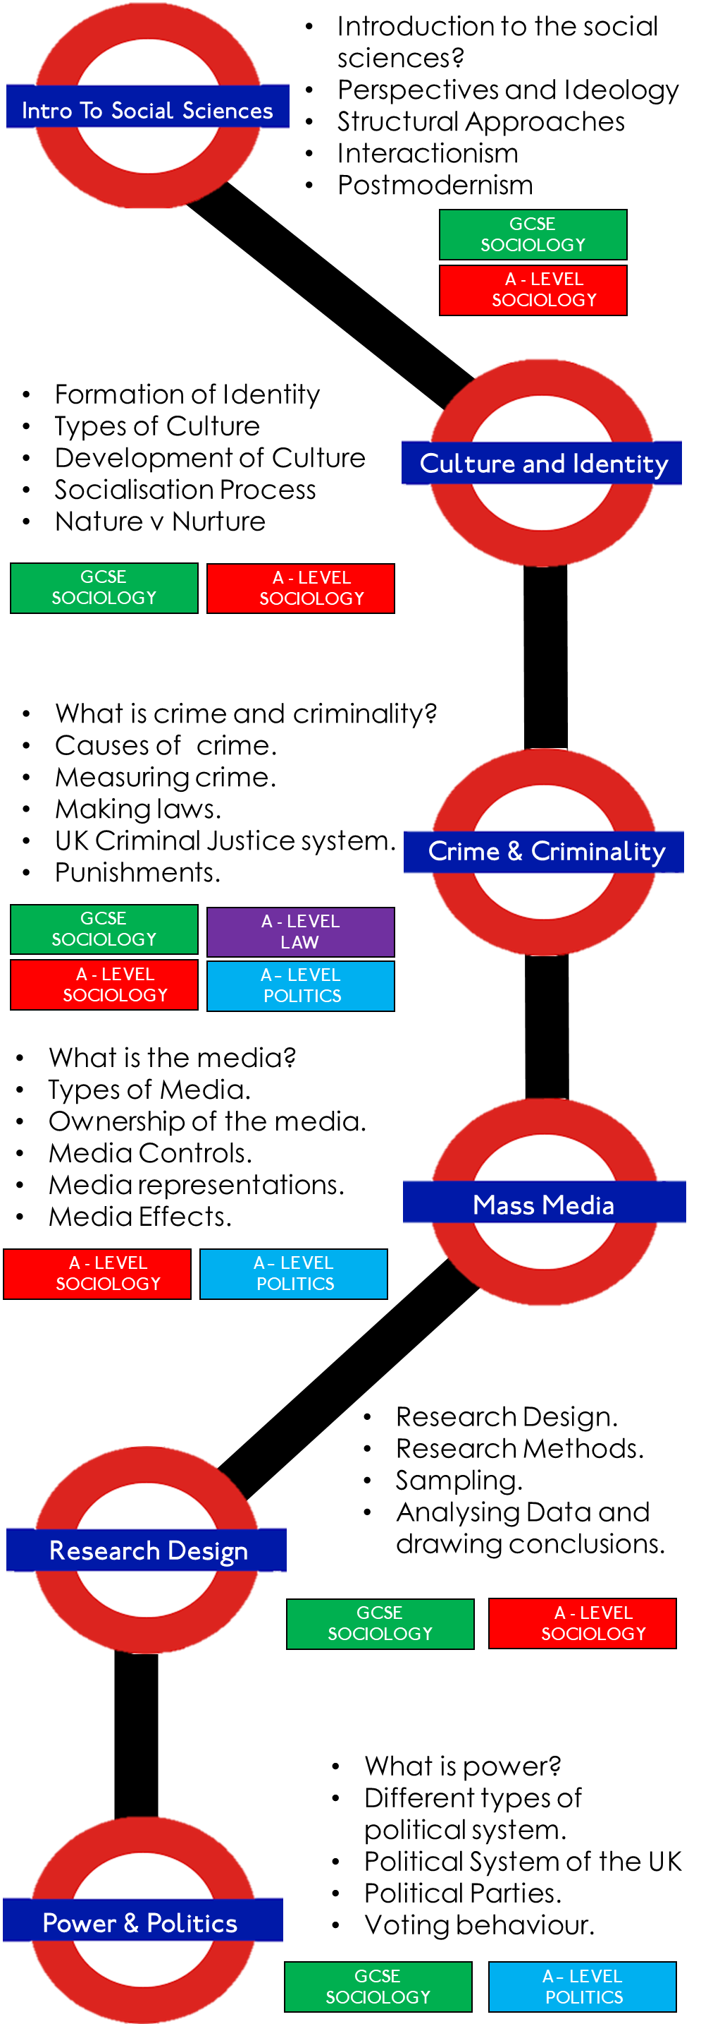
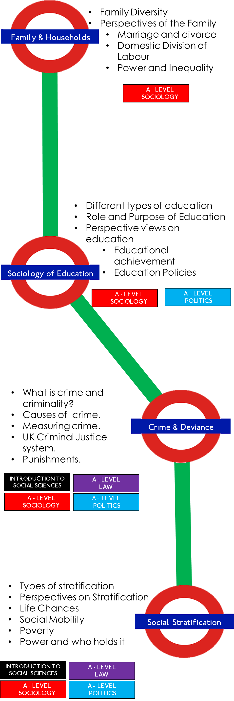
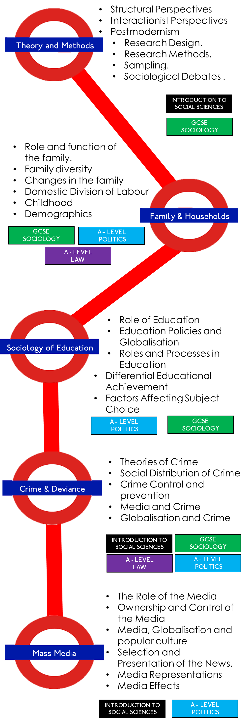
THE JOURNEY THROUGH SOCIOLOGY
@ WYMONDHAM COLLEGE

